Slide 1
NOISE REMOVAL FROM IMAGE

Slide 2
Index
1. Download Mnist Dataset By Using Sklearn:
2. To view the image
3. Split the data into train and test
4. Shuffle Our Training Data
5. We can do Trimming
6. Add noise in train dataset
7. View Noisy Image
8. Noise Removal from image by using KNN Model 9. Prediction on x_test_mod(noisy image)
10. To view the image after removing Noise
11. Accuracy

Slide 3
What is Mnist Dataset ?
The MNIST database (Modified National Institute of Standards and Technology database) is a large database of handwritten digits that is commonly used for training various image processing systems.
The database is also widely used for training and testing in the field of machine learning.

Slide 4
Download Mnist Dataset By Using Sklearn:
CODE:
from sklearn.datasets import fetch_openml
mnist = fetch_openml('mnist_784')
Saving mnist data in local file using joblib:
import joblib
joblib.dump(mnist,'mnist_datasets_joblib')
load mnist data from local file:
mj=joblib.load('mnist_datasets_joblib')

Slide 5
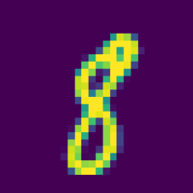
To view the image of single digit:
import matplotlib
some_digit = x.to_numpy()[300]
some_digit_image = some_digit.reshape(28, 28)
plt.imshow(some_digit_image)
plt.axis("off")
plt.show()

Slide 6
Split the data into train and test:
CODE:
from sklearn.model_selection import train_test_split
x_train, x_test, y_train, y_test= train_test_split(x, y,test_size= 1/7.0)

Slide 7
Shuffle Our Training Data:
CODE:
shuffle_index = np.random.permutation(60000)
x_train, y_train = x_train.iloc[shuffle_index], y_train.iloc[shuffle_index]

Slide 8
We can do Trimming:
CODE:
x_train = x_train[:30000]
y_train = y_train[:30000]
x_test = x_test[:5000]
y_test = y_test[:5000]

Slide 9
Add noise in train dataset:
CODE:
noise_train=np.random.randint(0,100,(len(x_train),784))
x_train_mod=x_train+noise_train
noise_test=np.random.randint(0,100,(len(x_test),784))
x_test_mod=x_test+noise_test
y_train_mod=x_train
y_test_mod=x_test

Slide 10
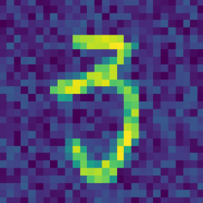
View Noisy Image:
CODE:
some_digit1 = x_train_mod.to_numpy()[250]
some_digit_image1 = some_digit1.reshape(28, 28)
plt.imshow(some_digit_image1)
plt.axis("off")
plt.show()

Slide 11
Noise Removal from image by using KNN Model
Classifying with noise:
from sklearn.neighbors import KNeighborsClassifier
knn_clf= KNeighborsClassifier()
knn_clf.fit(x_train_mod, y_train)
Cleaning of the noise using knn:
from sklearn.neighbors import KNeighborsClassifier
knn_clf1= KNeighborsClassifier()
knn_clf1.fit(x_train_mod, y_train_mod)

Slide 12
Prediction on x_test_mod(noisy image)
y_predict=knn_clf.predict(x_test_mod)
y_pre=knn_clf1.predict(x_test_mod)

Slide 13

After removing Noise:
plt.imshow((np.asarray(y_pre[250]).reshape(28,28)))
plt.axis("off")
plt.show()

Slide 14
Accuracy:
from sklearn.metrics import accuracy_score
accuracy_score(y_test,y_predict)
Output:
0.9598

